Slide 1

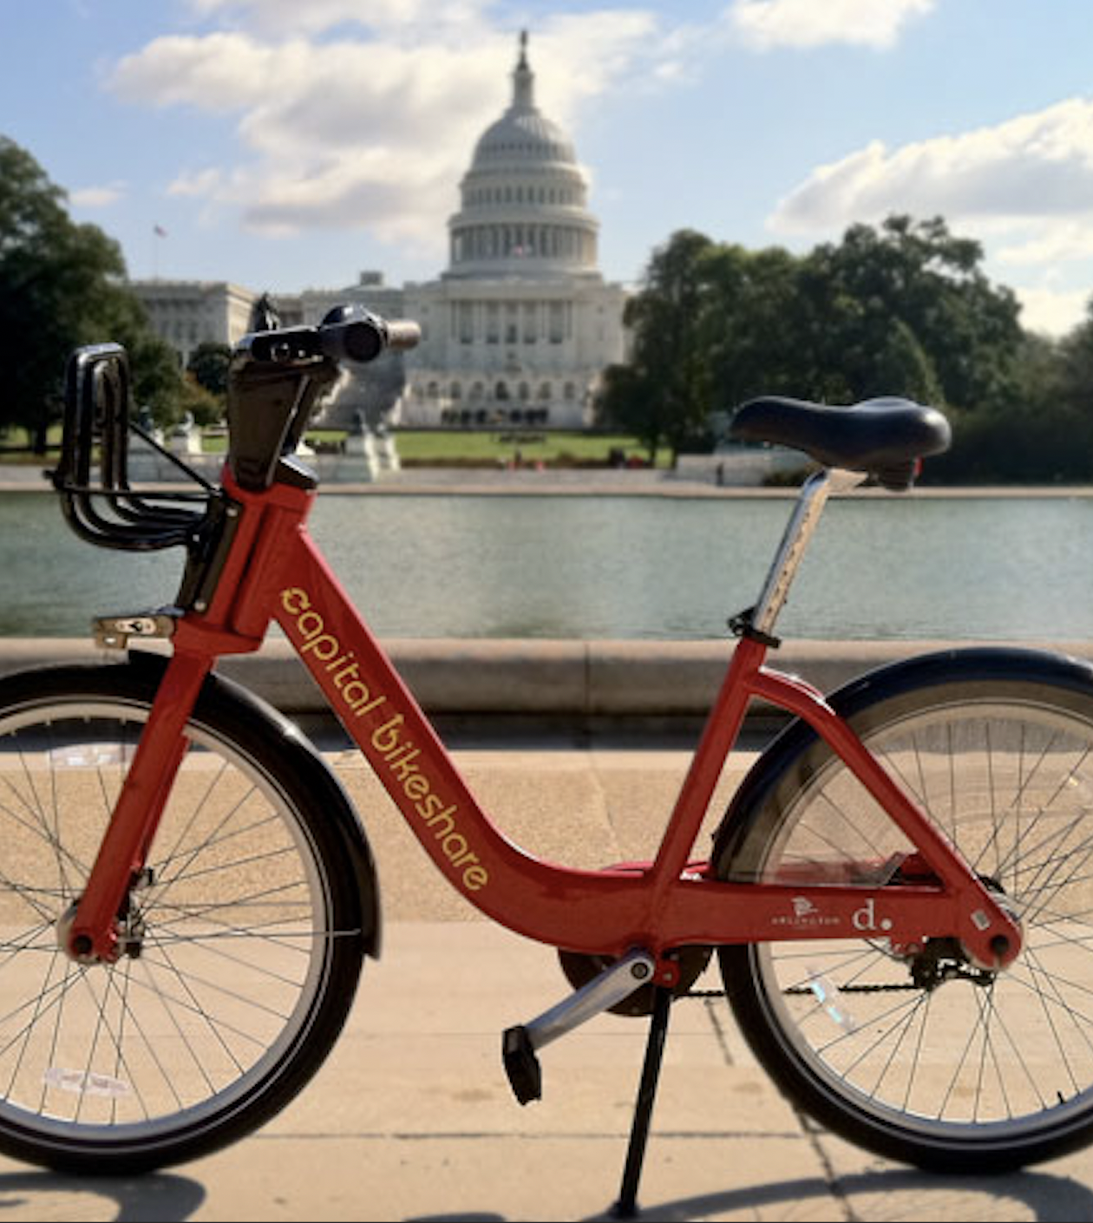
Why you Bikein’?
TEAM
Mihir Deshpande (MD46487)
Pengwei Wang (PW8574)
Sreekar Lanka (SL54387)
Akhila Guttikonda (AG79445)
Parthiv Borgohain (PB25347)

Slide 2
Agenda
Problem Statement
Predict the demand of bike users based on the number of rides w.r.t casual and registered users.
1
Data Explanation
A normalized set of 17580 rows having number of casual and registered rides based on day of the week, month, years season and multiple weather variables.
2
Exploratory Data Analysis
Analyzing the number of rides based on categorical variables (day of the week, season and weather variables)
3
Data Preprocessing
One Hot encoding - data transmitted into 0 and 1 to turn categorical variables to numerical variables
4
Model Selection
Non-parametric and parametric model selection : Multiple regression, Trees and Knn
5
Notes:
This is how we planned our workflow since Day 1 after selecting the data set.

Slide 3
Problem Statement
Bike sharing is one of the most accessible way to commute for employees and students. Lime and Bird were the commonly used bikes in Austin especially for student commute and it is interesting to see how the membership, payment and trips have become more automatic.
Inspired by these observations, we took the trips data from Capital Bikeshare^{[1]} to predict the demand of bike users based on the number of rides pertaining to registered and casual users.
[1] Capital Bikeshare – State owned bike sharing system in counties around Washington D.C and Virginia
Notes:
Ever since we were here in Austin, we saw a number of bikes stacked by the walkways. I personally felt this was a convenient mode of commute on the way to college. Inspired by these experiences that me and my team had, we took the trips data from Capital Bikeshare to predict the demand of bike users w.r.t the type of users whether they are registered or casual

Slide 4
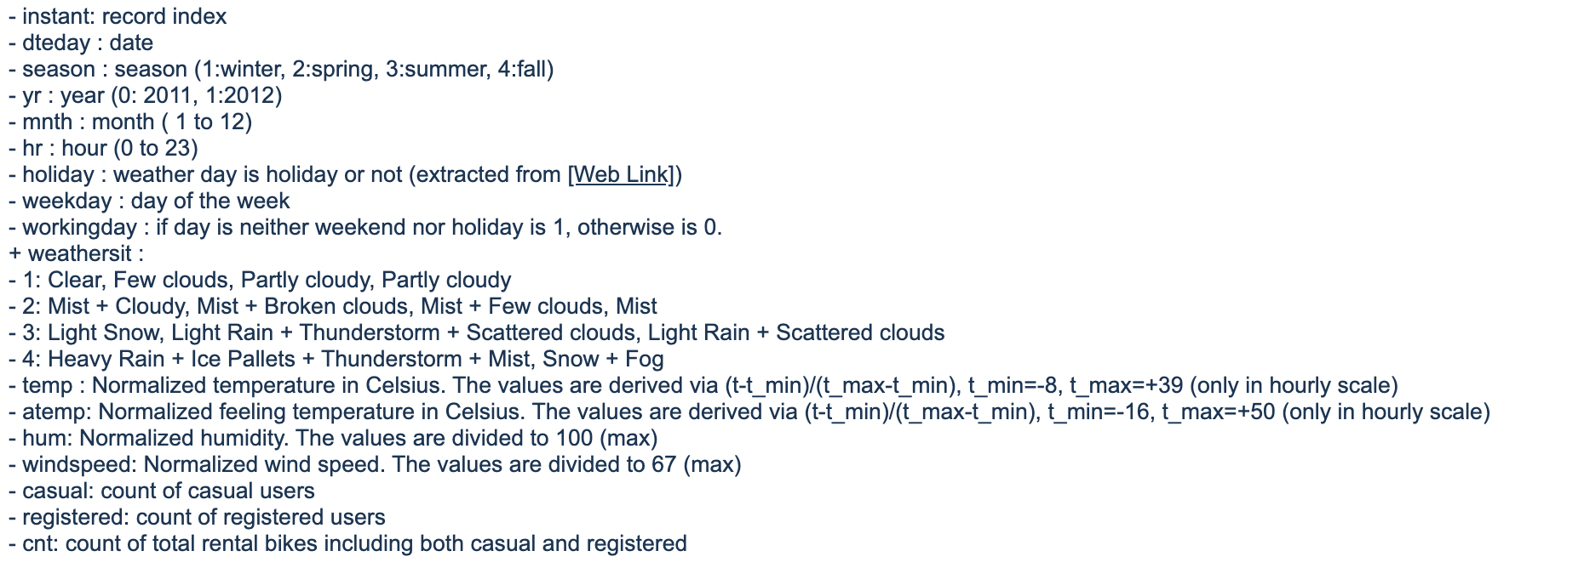
Data Explanation
Data set : 17380 rows
Processing : One hot encoding to convert data from categorical to numerical as we are predicting a quantitative factor. Also removed highly correlated variables to reduce the RMSE.
Training 50%
Testing 25%
Validation 25%
Dataset obtained from University of California, Irvine archive (2nd hand) - https://archive.ics.uci.edu/ml/datasets/Bike+Sharing+Dataset
Original data (1st hand) sourced from Capital Bikeshare system data archive - https://ride.capitalbikeshare.com/system-data
Notes:
Our data is already normalized having 17380 rows in total. The data comprises of the number rides registered and casual users are taking on an hourly basis and how the number of rides change based on Day of the week, Season and Weather situations etc.
We’ve also done One Hot encoding to convert the data from categorical to numerical as we are trying to predict a quantitative factor. We’ve taken 50% of our data to be training, 25% to be testing and 25% to be validation.

Slide 5
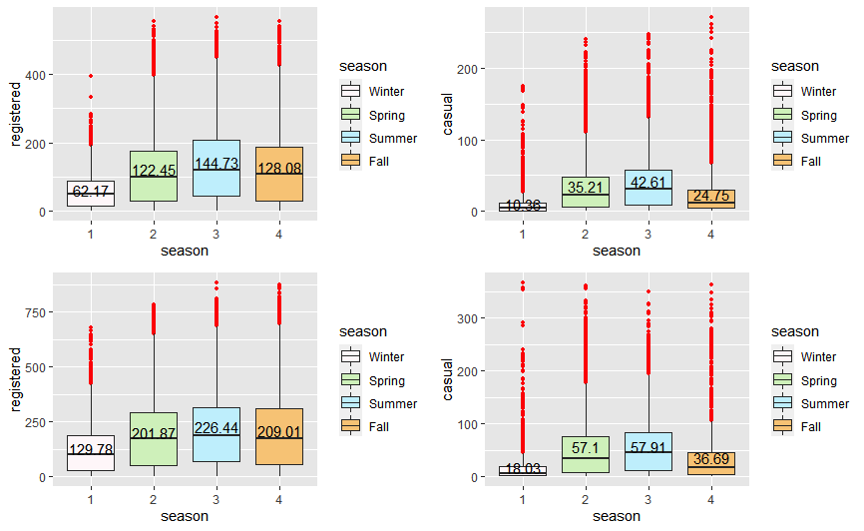
Exploratory Data Analysis
2011
2012
Season wise registered and casual rides per hr
Both registered and casual users had increased number of rides in Summer and Spring
Large range of outliers for casual users while the registered users have a small range with higher magnitude
Notes:
Here’s the seasonal analysis on the number of rides wrt registered and casual users for the years 2011 and 2012. We have observed that the number of rides for registered is significantly more than that of the casual rides in both the years. Summer has the maximum number of rides followed by Spring and then Fall. Winter has got the least number of rides. While Casual rides follow a similar seasonal patterns , the magnitude of rides are really less that are within the average and we have observed a significant range of outliers for casual rides.

Slide 6
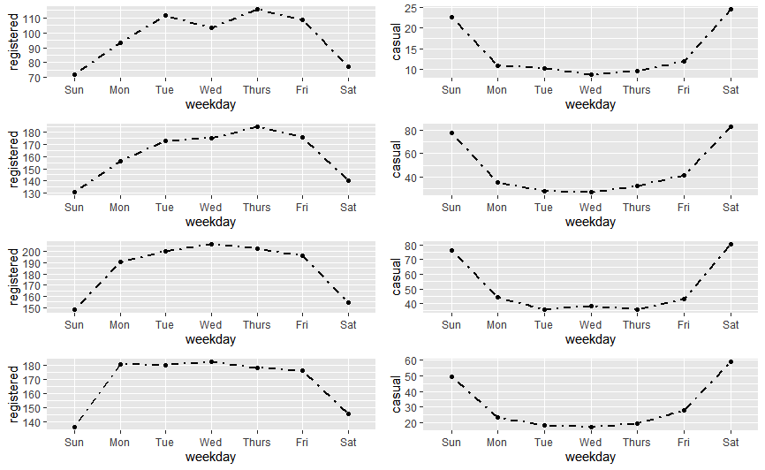
Exploratory Data Analysis
winter
A contrasting pattern in the number of rides observed for both registered and casual riders
Increased number of rides over the week and decreased number of rides over the weekends for registered users
Decreased number of rides in weekdays and increased number of rides over the weekends for casual users
spring
summer
fall
No. of rides for registered and casual across the week w.r.t seasons
Notes:
In addition to the seasonal analysis, we’ve drilled down the number of rides per season further to day of week for both registered and casual users. We have observed high number of rides for registered users across the week and a significant decrease over the weekend. We have seen a contrasting model for casual users where the number of rides in the weekend are higher than the ones across the week.

Slide 7
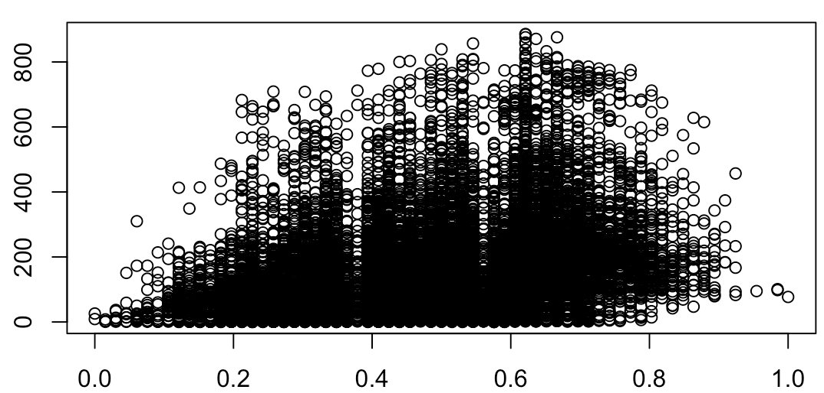
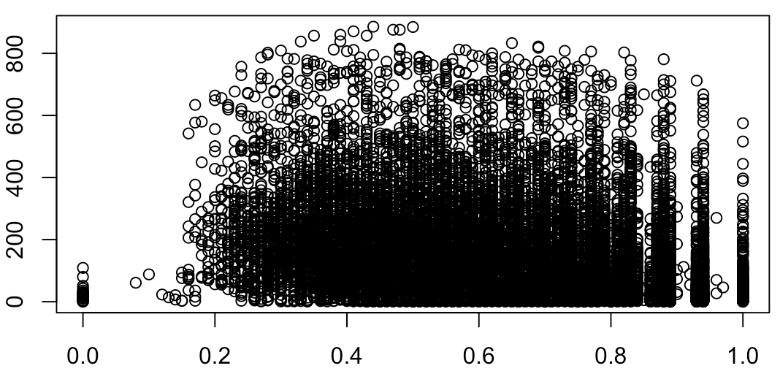
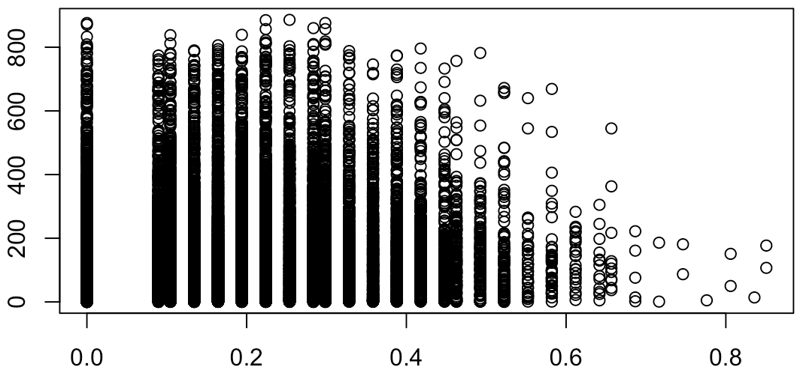
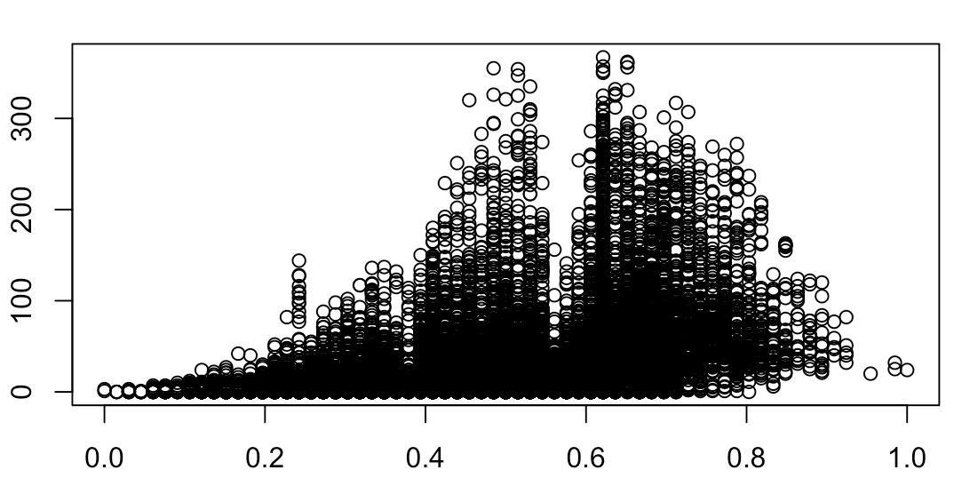
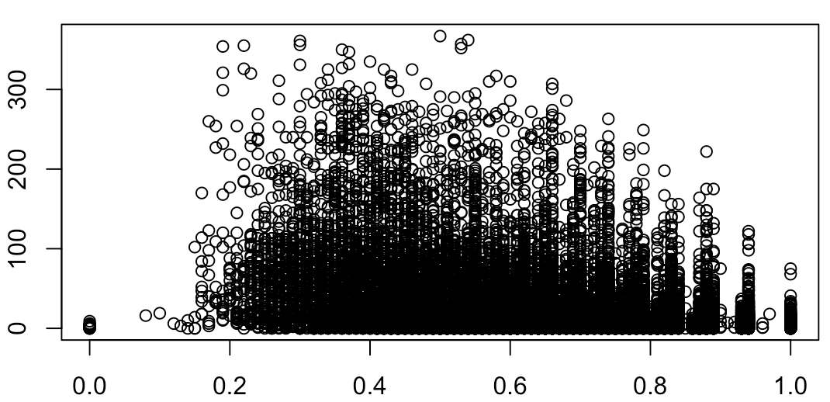
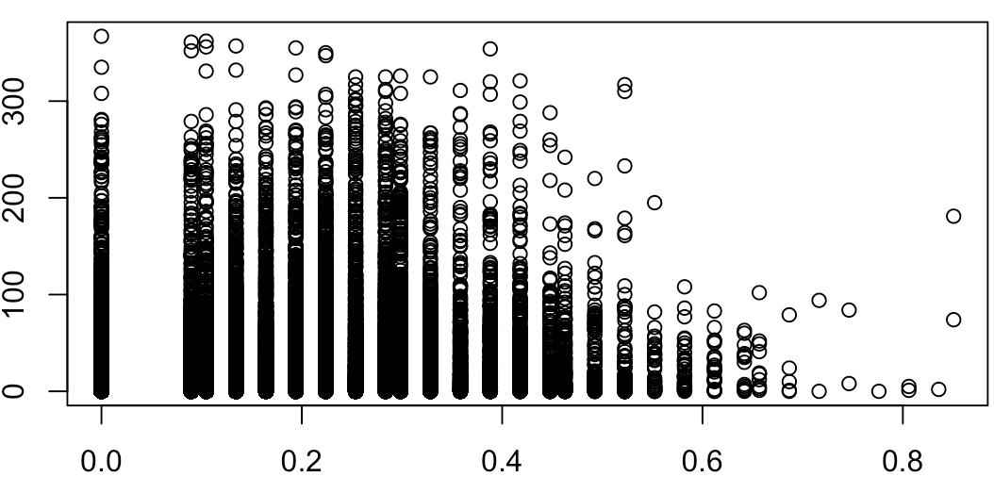
Exploratory Data Analysis
registered
atemp
humidity
windspeed
casual
atemp
humidity
windspeed
Notes:
We can see that there isnt a significant influence of weather conditions like humidity, windspeed and temperature on the registered user rides while casual users are subject to an influence based on weather conditions.

Slide 8
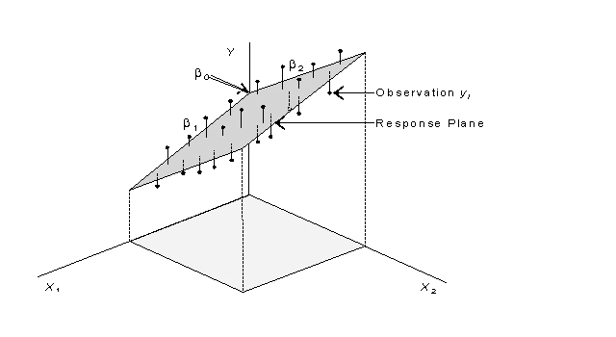
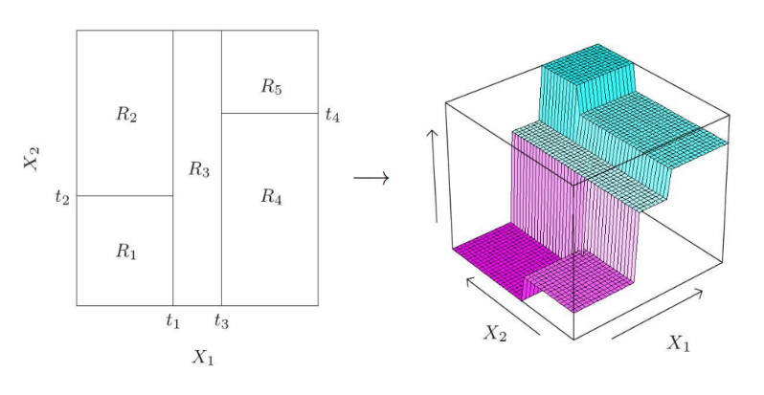
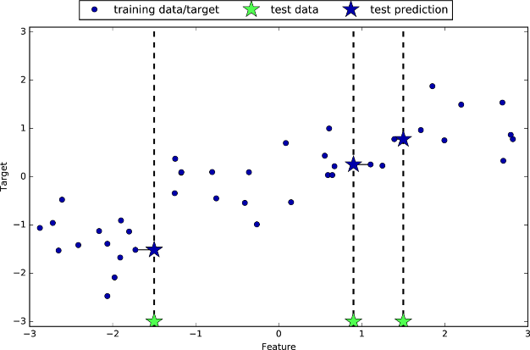
Approach
- Build separate models for registered users and casual users
3 approaches to consider – Regression, K Nearest Neighbours, Trees
Parametric
Non - Parametric
K Nearest Neighbours
Multilinear Regression
+
(Ridge and Lasso)
Tree Regression
Notes:
Based on the analysis of different patterns that we observed for casual and registered users, we decided on running both parametric and non parametric models. We’ve talen

Slide 9
Multilinear Regression
Data Pre-Processing
1) Encoding Categorical Variables
(converting factors to integer inputs)
Two methods –
Ordinal Encoding and OneHot Encoding
season = {1, 2, 3, 4} ->
e.g.
season
1
2) Removing unnecessary variables
instant (serial no.), dte (date), yr (year), cnt (total rides per hour)
A) For ‘registered’ users
casual (no. of casual rides per hour)
B) For ‘casual’ users
- registered (no. of registered rides per hour)
season_1 = {0, 1}
season_2 = {0, 1}
season_3 = {0, 1}
season_4 = {0, 1}
s_1 s_2 s_3 s_4
0 0 1 0
Standard 80-20 split for training and test/validation sets

Slide 10
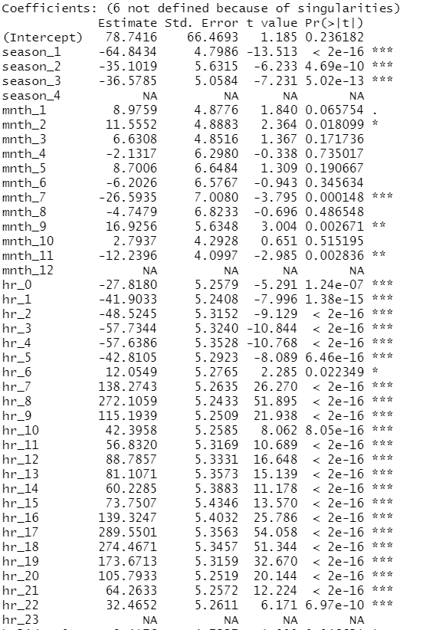
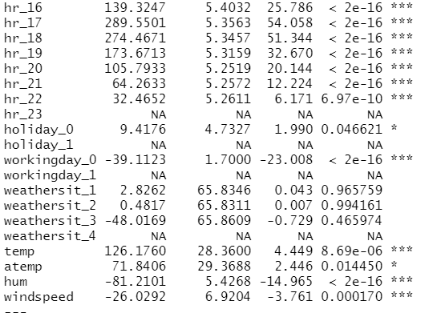
Multilinear Regression
Registered Users
Simple model with all predictors -
Standard 80-20 split for training and test/validation sets

Slide 11
Multilinear Regression
Registered Users
What are singularities ?
Singularity is the extreme form of multicollinearity - when a perfect linear relationship exists between variables or, in other terms, when the correlation coefficient is equal to 1.0 or -1.0
Usually happens when encoding dummy variables during data preprocessing
Leads to incorrect calculations of coefficients with the OLS method
X₁= a*X₂ + b*X₃ + c

Slide 12
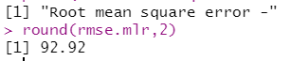
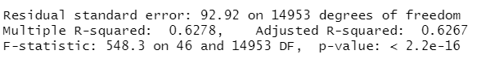
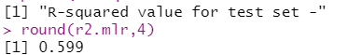
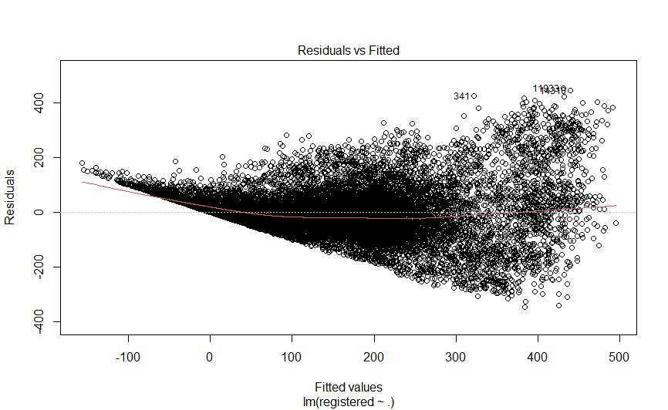
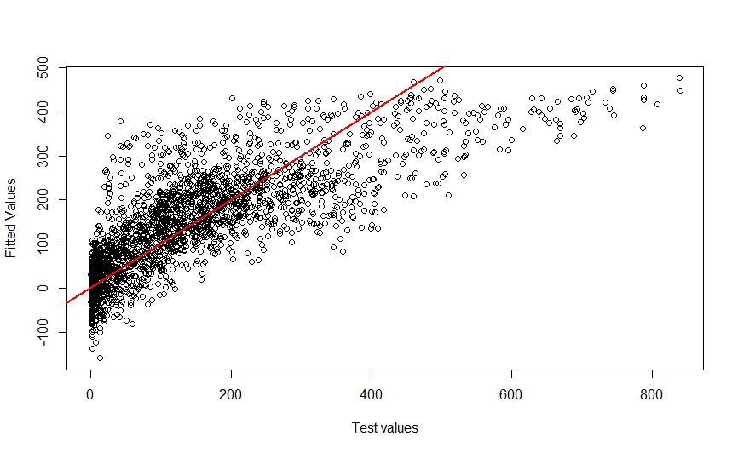
Multilinear Regression
Registered Users

Slide 13
Multilinear Regression
Registered Users
Other model building techniques to consider -
Nth root model with all predictors –
Log model with all predictors – (Note we added a value of 1 to registered no. of riders per hour because we log(0) is not defined)
Standard 80-20 split for training and test/validation sets

Slide 14
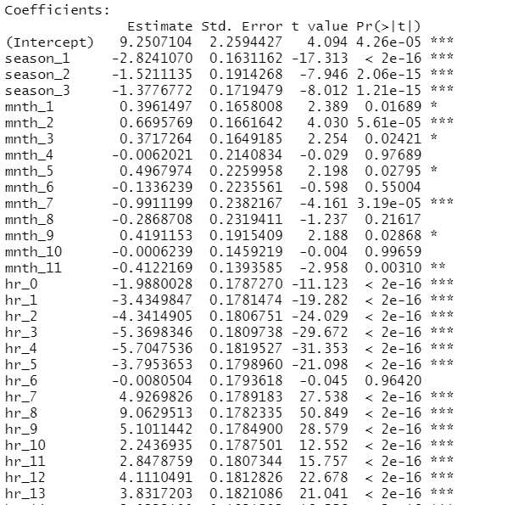
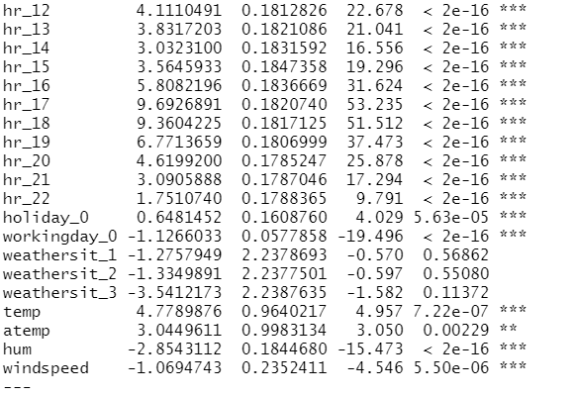
Multilinear Regression
Registered Users
Nth root model with all predictors -
N = 2
Standard 80-20 split for training and test/validation sets

Slide 15
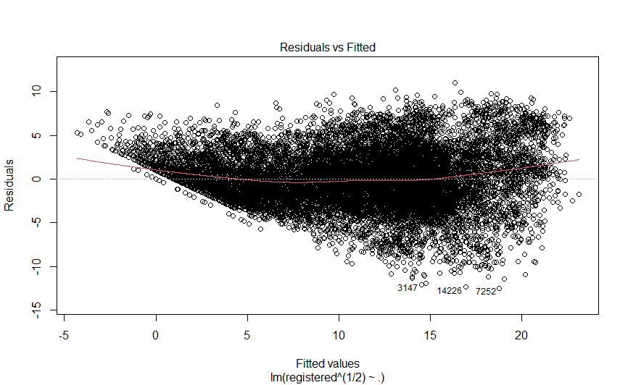
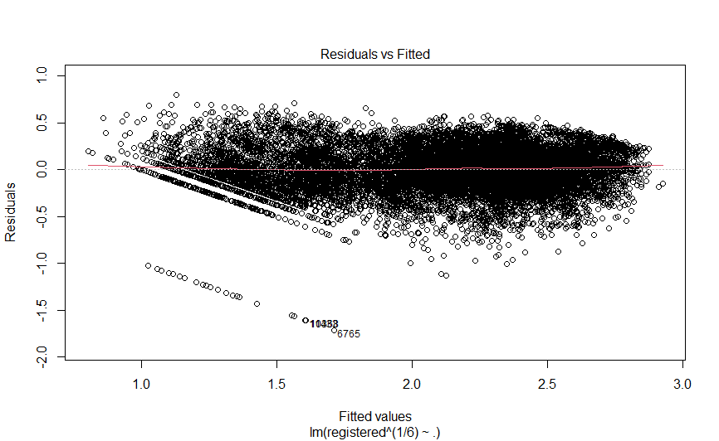
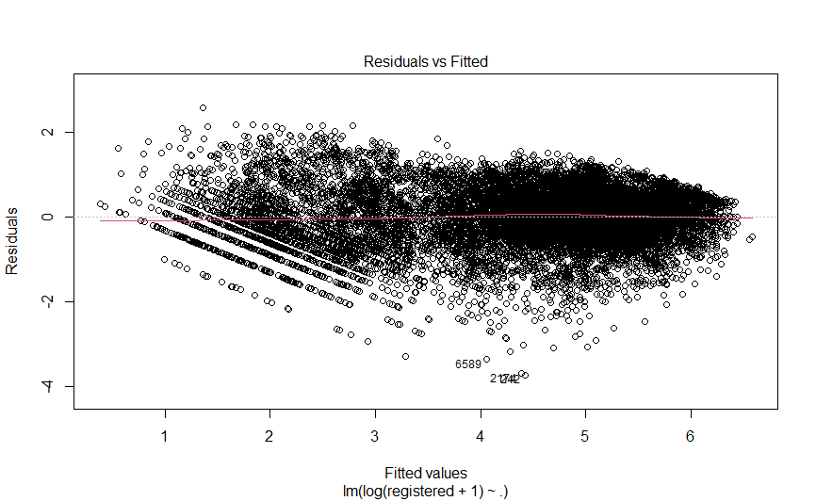
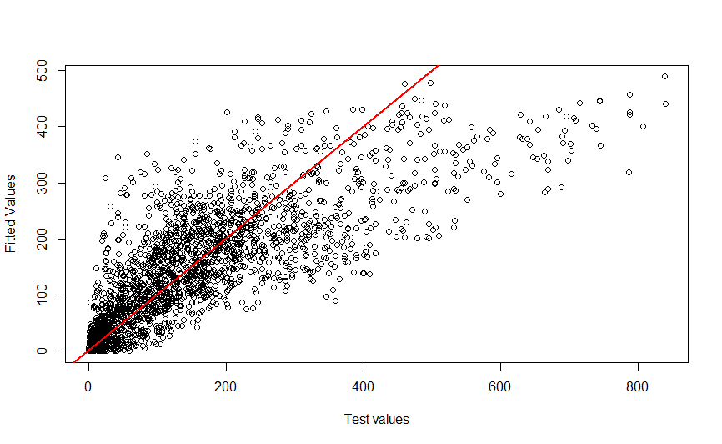
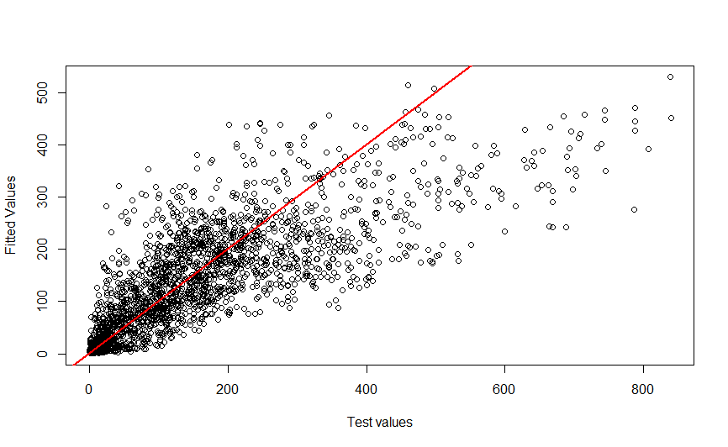
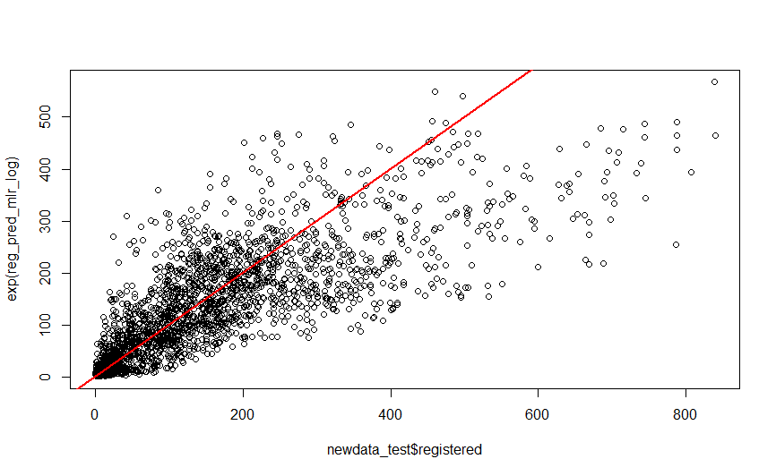
N = 2
N = 6
Log Model

Slide 16
Multilinear Regression
Registered Users
Model (Regression) | RMSE (training) | RMSE (test) | R-square (training) | R-square (test)
Simple | 92.921 | 92.92 | 0.6267 | 0.599
2nd Root | NA | 88.99 | 0.729 | 0.632
6th Root | NA | 90.62 | 0.7731 | 0.617
Log Model | NA | 92.72 | 0.786 | 0.6008

Slide 17
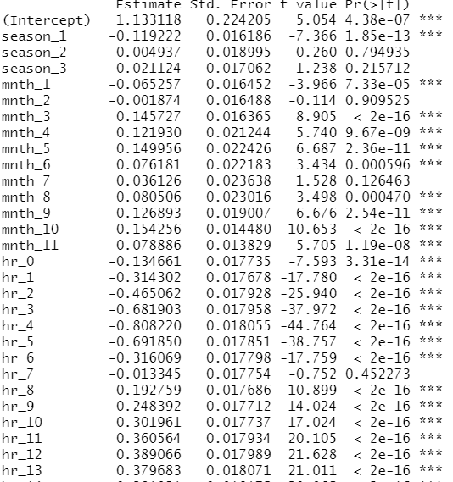
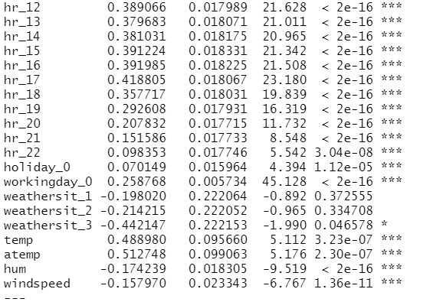
Multilinear Regression
Casual Users
Root (N=6) model with all predictors -
Standard 80-20 split for training and test/validation sets

Slide 18
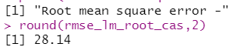
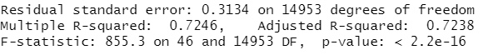
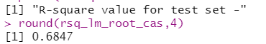
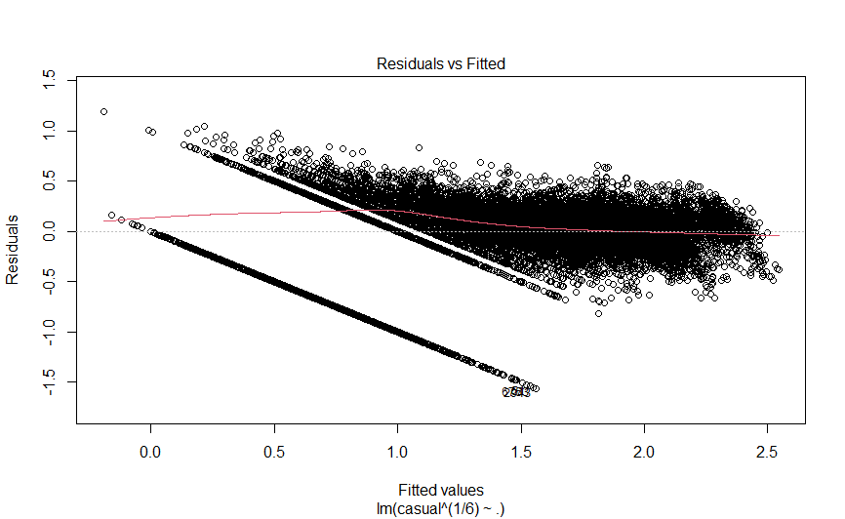
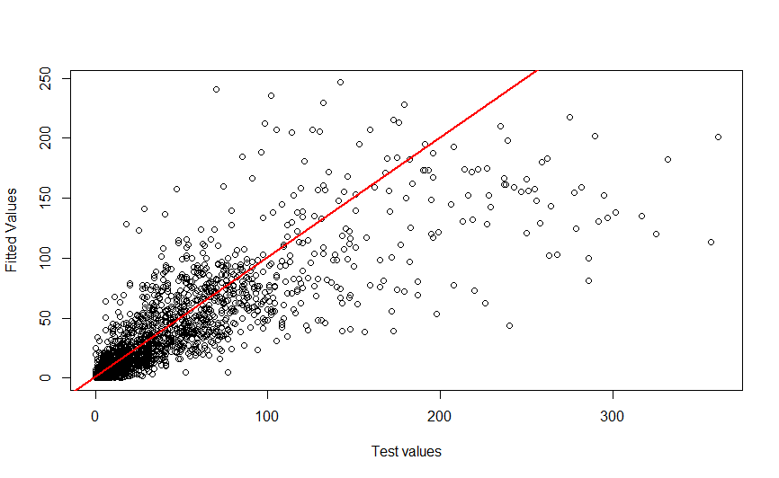
Multilinear Regression
Casual Users

Slide 19
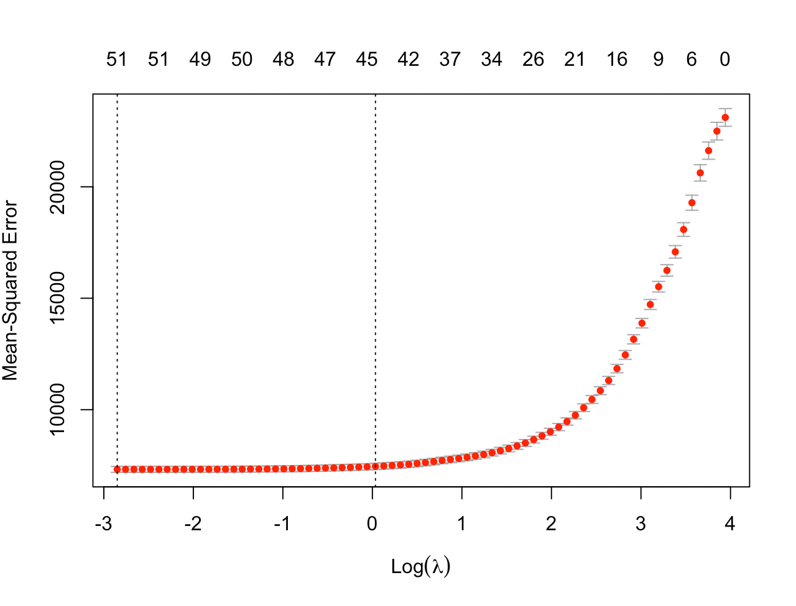
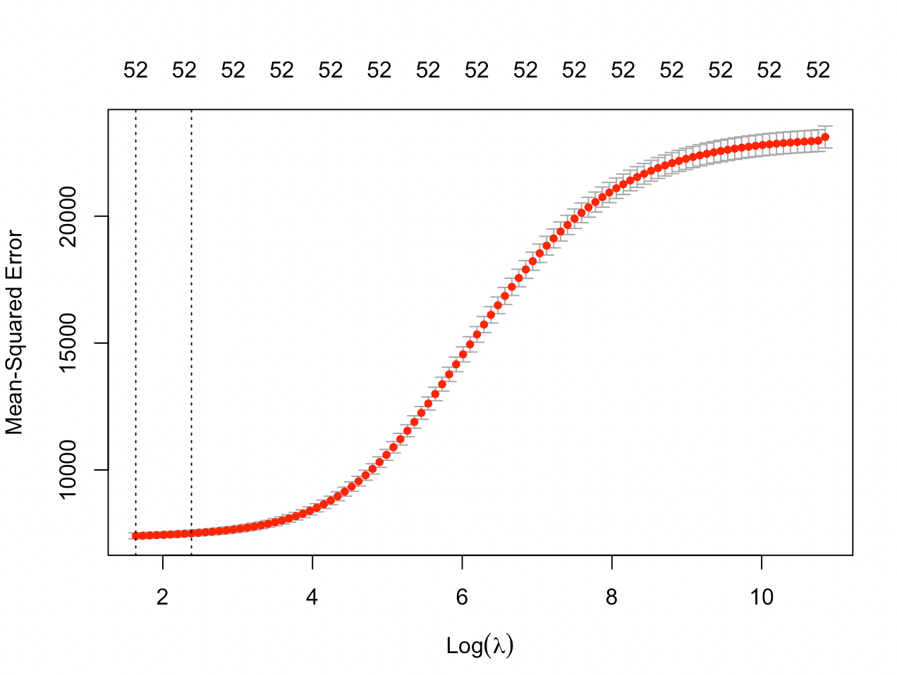
Lasso and Ridge Regression
We tried to predict the registered users using regularization models - Lasso and Ridge regression
Lasso Regression
Ridge Regression
Training data
Test data
Training data
Test data
- R square_test - 0.68
- RMSE_test - 85.29
- R square_test - 0.66
- RMSE_test - 85.55
- R square_test - 0.68
- RMSE_test - 85.71
- R square_test - 0.65
- RMSE_test - 90.20
Lasso regression removes the predictors -
mnth_4 and weathersit_2
Ridge regression shrinks the following predictors to 0 -
mnth_3 and hr_22

Slide 20
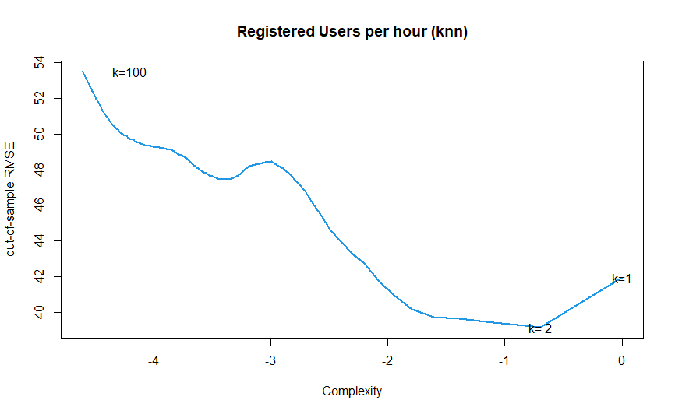
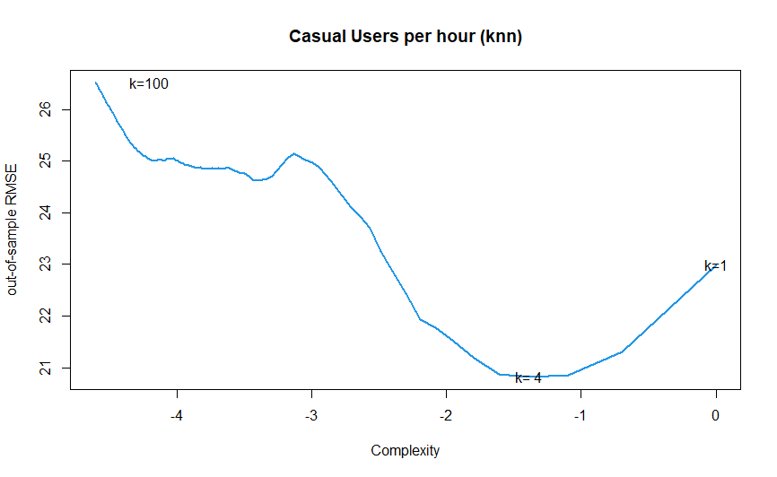
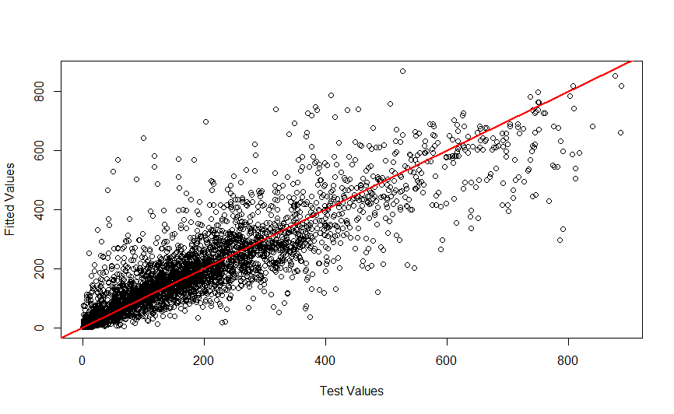
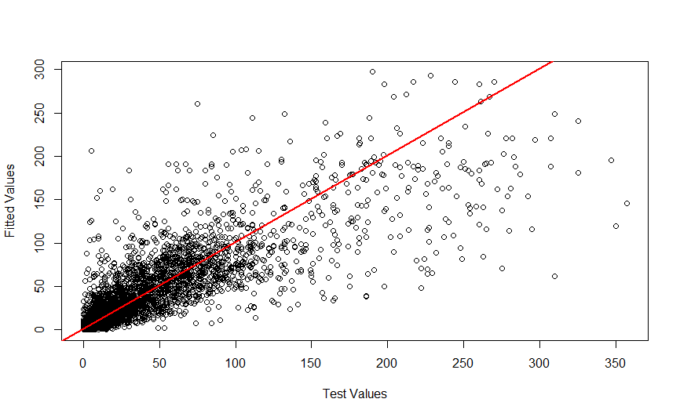
K Nearest Neighbours

Slide 21
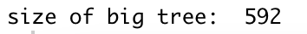
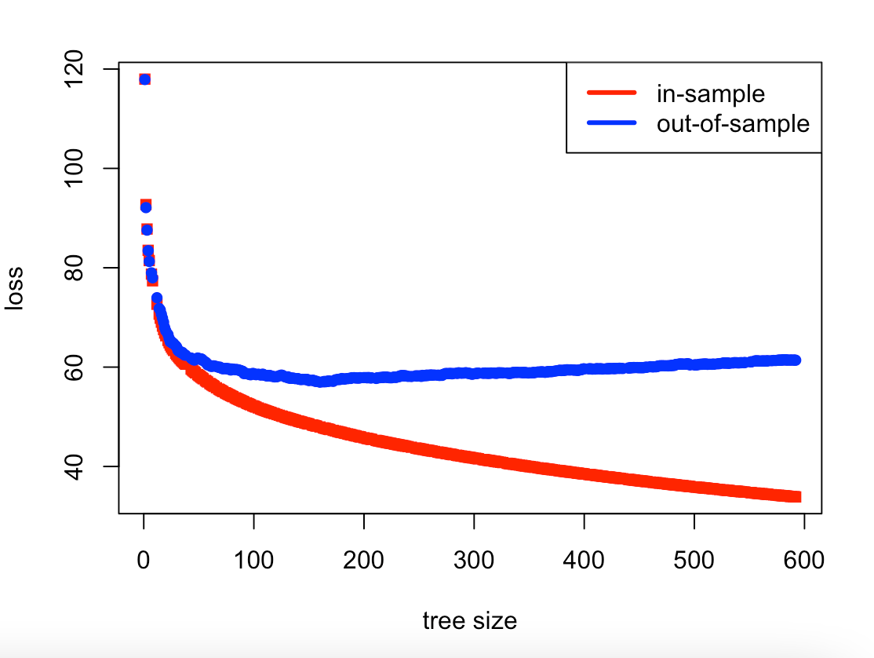
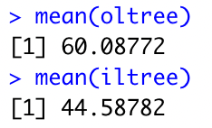
Trees
Fit a big tree using rpart
For Registered Users:
We first fit a big tree to the training set through a very small CP value.
Then we fit on the training set and predict on the validation set.
Mean in sample loss came to be 44.58, but mean out of sample loss is 60.08!
Notes:
First we used RPart to fit a big tree. Since the CP is the minimum improvement needed at each node, we are allowing the tree to grow through a very small CP. Now we try fitting it to the training set and predict on the validation set, and we get an average RMSE of 44.58 in sample and 60.08 out of sample. The individual tree is overfitting the training data and therefore we can see that we get lower RMSE in sample with bigger trees but not the case for out of sample predictions.

Slide 22
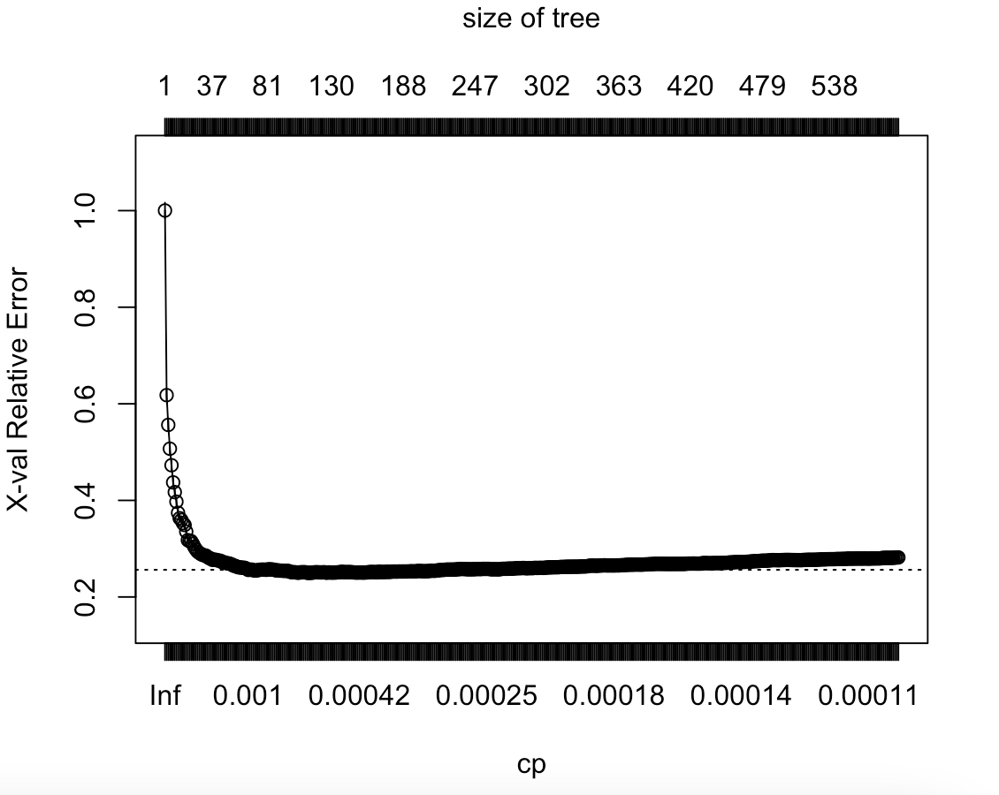
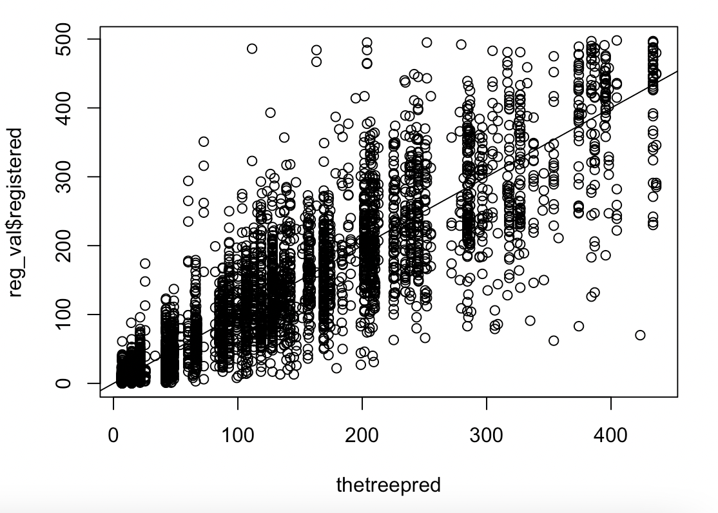
Trees
Pruning the tree
For Registered Users:
Let’s look at the cross validation results from plotcp.
Prune the tree using the CP value that gave us the lowest out of sample loss
76.64% Variance Explained
56.96 RMSE
Notes:
Let’s look at a graphical representation of the cross-validated results from plotcp. Now let’s prune the tree using the CP value that gave us the lowest loss out of sample, and we get RMSE of 56.96 in the validation set, and 76.64% variance explained. We can see that even with a pruned tree, it is not doing a very good job predicting the number of registered users out of sample.

Slide 23
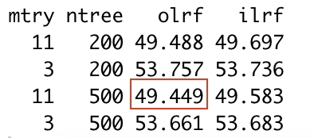
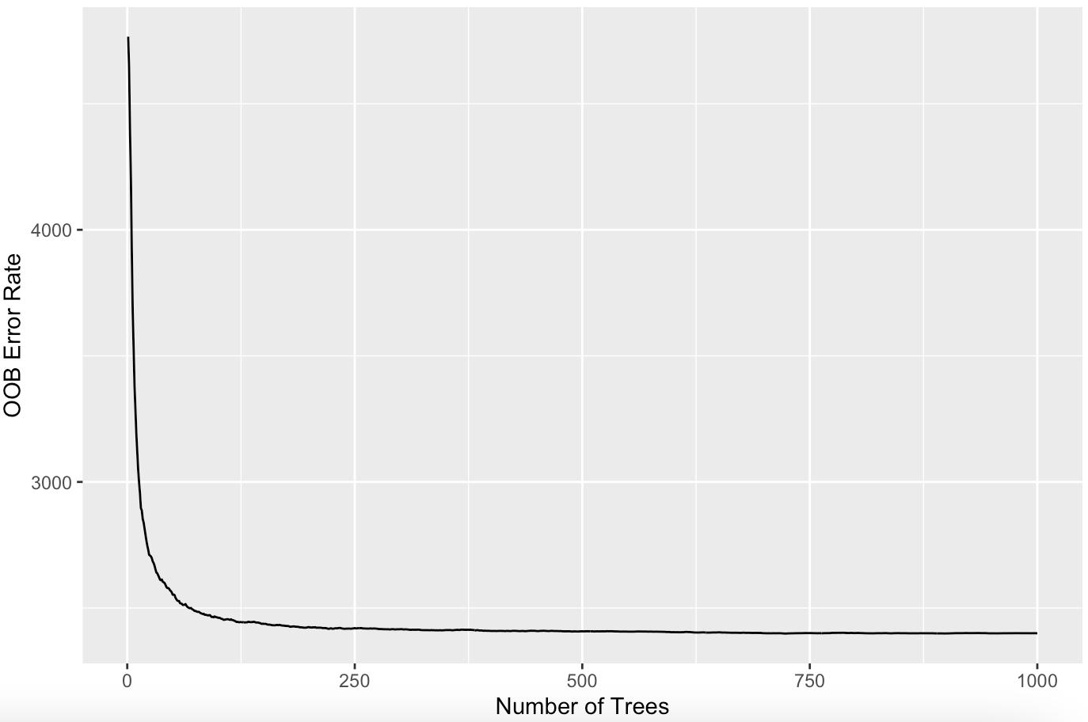
Random Forests
For Registered Users:
Using random forests, we first tried 11 predictors (bagging) and 3 predictors with 200 and 500 trees.
Minimum out of sample loss of 49.50 is much better than pruned tree
Clearly, out of sample loss is lesser when we use the entire predictor set
Notes:
Using random forests, we first tried using 11(bagging) and 3 predictors with 200 and 500 trees. We can see that we get a minimum out of sample loss of 49.449, which is much better than a pruned tree. Plotting the out of bag errors against a random forest of 1000 trees demonstrates that it does not take a large number of trees to minimize the prediction error estimates. Clearly we get a lower out of sample loss when we use the entire predictor set. Therefore we suspect that it is possible that these predictor variables are correlated to each other and we are getting some variable interaction. Thus we want to see if we can reduce the prediction errors further by exploring with bagging a little more.

Slide 24
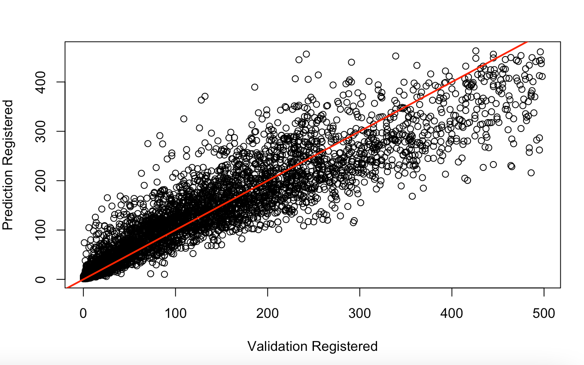
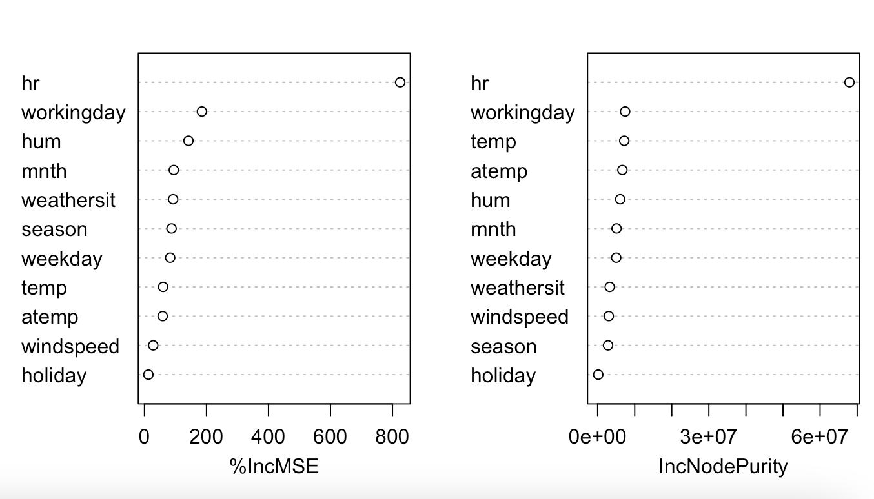
Random Forests (Bagging)
For Registered Users:
Thus, we wanted to see if we can get better results by exploring more with bagging
In fact we can! 1000 trees and 100 trees both gave us very similar OOB RMSE of ~48.8 and ~82.8% Variance Explained
Hr is clearly the most impactful variable
Notes:
What we found was that using 100 trees both gave us out of bag loss of around 48.8 and 82.8% variance explained. This suggests that the improvement in prediction performance with more trees is negligible, and we would favor the bagging model with 100 trees for efficiency. Looking at the variable importance, hr is clearly the most impactful variable.

Slide 25


Boosting
For Registered Users:
We wanted to see if we could improve the results by tuning the parameters through boosting
Best in sample loss: 5.463
Best out of sample loss: 48.399
Again, hr is the most important variable
Notes:
We then tried boosting to see if we can get a better result by tuning the depth, number of trees and lamba (which is the crushing parameter). We were able to find the best out of sample loss of 48.39 using a depth of 20, 500 trees and 0.05 lambda. We can see that increasing the depth, which also increases the complexity of the tree actually contributed the most to reducing out of sample loss, which is consistent with what we suspected using bagging, since increasing the complexity captures the stronger variable interactions better. Also, fitting a large number of trees results in the best in sample error of 5.4 but it is overfitting and results in poor out of sample predictions. So we get pretty much the same result from boosting and bagging, and we can see that hr is again the most important variable by far.

Slide 26


Fit on Testing Set
Notes:
Now we fit the best bagging and boosting methods to the combined training and validation set, and get the loss on the testing set. We find that the results are consistent with what we found in the validation set. From boosting, we get 84.84% variance explained and 45.6 RMSE on the testing set. From bagging, we get 82.2% variance explained and 46.2 RMSE. So both bagging and boosting produced similar results on the testing set, with boosting just slightly better.

Slide 27
Fit on Testing Set
Registered Users | RMSE (Validation) | RMSE (Test) | R-square (Validation) | R-square (Test)
Pruned Tree | 56.9 | NA | 76.6% | NA
Random Forest(Bagging) | 48.8 | 46.2 | 82.2% | 83.5%
Boosting | 48.3 | 45.6 | 84.8% | 84.4%

Slide 28



Casual User Predictions
For Casual Users:
We used the same approach in predicting the registered users and found that boosting & bagging produced very similar results in the test set
Casual Users | RMSE (Test) | R Squared (Test)
Random Forest (Bagging) | 17.01 | 87.8%
Boosting | 17.13 | 88.7
Notes:
We used the same approach to predict the casual users, and we found that boosting and bagging produced very similar results in the test set, and both were significantly better than fitting a pruned tree. Plotting the users against hours, we can see that there is a clear pattern where there are significantly more registered users during rush hours, whereas for the casual users it’s more spread out during the day. Looking at the variable influence, we can observe that hour is still the most impactful variable in predicting casual users, but the temperature variables’s relative influence have increased.

Slide 29



Slide 30
Conclusion
On running multiple linear regression, we found that the best fit was the square root model. So this implied that at least a square relationship existed.
The coefficients in our Square Root MLR model seemed to agree with the initial Exploratory Data Analysis for both registered and casual users.
As expected, a non parametric model like trees worked best for our dataset which had multiple nominal categorical variables (without an inherent order).
So, the major factor influencing registered users was Hour of the Day, while the temporal/weather factors were not as important.
On the other hand, while the Hour of the Day was still the most important variable influencing the casual riders, the Temperature too was of considerable importance.

Slide 31
Next Steps
For casual users, we can try introducing a weekend pass model to take advantage of the positive correlation between no. of casual users and weekend days.
Price surging/dynamic pricing can be based on weather conditions (temperature) for casual users. E.g. if it is a hot, sunny day and a weekend, our model says that there should be a higher number of casual users. It can be a good opportunity to raise prices.
Using our model, Capital Bikeshare can perform demand and supply planning with reasonable accuracy.
Finally, Capital Bikeshare should hire us for a model with even better accuracy!!

Slide 32
THANK YOU!!

